Slide 1
6-Oct-17
Resilient
Aspirational
Independent
Supportive
Engaged
Venn Diagrams
Learning Objective:
Be in my construction of Venn diagrams.
Starter:
454 + 528
768 – 375
23 x 7
354 ÷ 6
In a class of 30 students, of which 8 girls who liked hockey and 4 boys did not.
If there are 17 girls in the class, how many boys like hockey?
resilient
= 982
= 393
= 161
= 59
9 boys like hockey

Slide 2
SETS
In maths, a set, is a collection of items/numbers.
Similar to school, where classes are often called sets.
In school a set is collections of students.

Slide 3
SETS
First up we need to introduce some new notation (symbols) that mathematicians use when defining sets.
Example
A = {1, 2, 4, 5, 8}
This means that the set A contains the numbers 1, 2, 4, 5 and 8.

Slide 4
VENN DIAGRAM
Venn diagrams are a way we can collect, and often sort, sets.
The reason we use Venn diagrams is that they provide a really nice visual way of sorting sets.

Slide 5
VENN DIAGRAM
A Venn Diagram quite simply consists of a Box with Circles in it.

Slide 6
VENN DIAGRAM
Quite often you will see the circles overlapping like this:
But what’s the difference? Let’s have a look….

Slide 7
VENN DIAGRAM
Set A contains the numbers 1, 3, 4, 5, 6, & 7.
Using set notation we can write; A = { 1, 3, 4, 5, 6, 7}

Slide 8
VENN DIAGRAM
Set B contains the numbers 2, 4, 7, 8, & 9.
Using set notation; B = { 2, 4, 7, 8, 9}

Slide 9
EXAMPLE
The sets A and B are now in the Venn diagram below.
A
B
1
8
6
4
5
9
3
7
2

Slide 10
VENN DIAGRAM
Set A = { , , , , , }
A
B
1
1
8
4
6
4
6
5
5
9
7
3
7
3
2
Notes:
To bring some interaction to the lesson ask students to name a number in Set A. For good practice also emphasis to arrange numbers with set from smallest to largest.

Slide 11
VENN DIAGRAM
Set B = { , , , , }
A
B
1
1
8
8
4
4
6
4
6
5
5
9
9
7
7
3
7
3
2
2
Notes:
To bring some interaction to the lesson ask students to name a number in Set A. For good practice also emphasis to arrange numbers with set from smallest to largest.

Slide 12
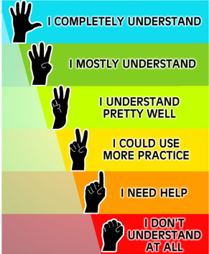

Slide 13
QUESTION
A
B
7
8
6
1
9
3
4
5
2
List set A and set B
A = { , , , , , } B = { , , , , }
A = {1, 2 , 3, 4, 6, 7} B = {1, 4, 5, 8, 9}
Notes:
Students could be asked to draw this Venn Diagram in there books for reference to all of the lessons Q’s.

Slide 14
INTERSECTION
An intersection refers to the numbers that appear in all (both) of the sets (circles).
A
B
1
8
4
6
4
5
9
7
3
7
2

Slide 15
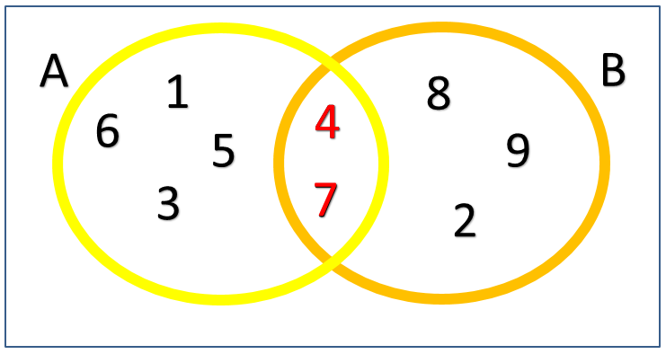
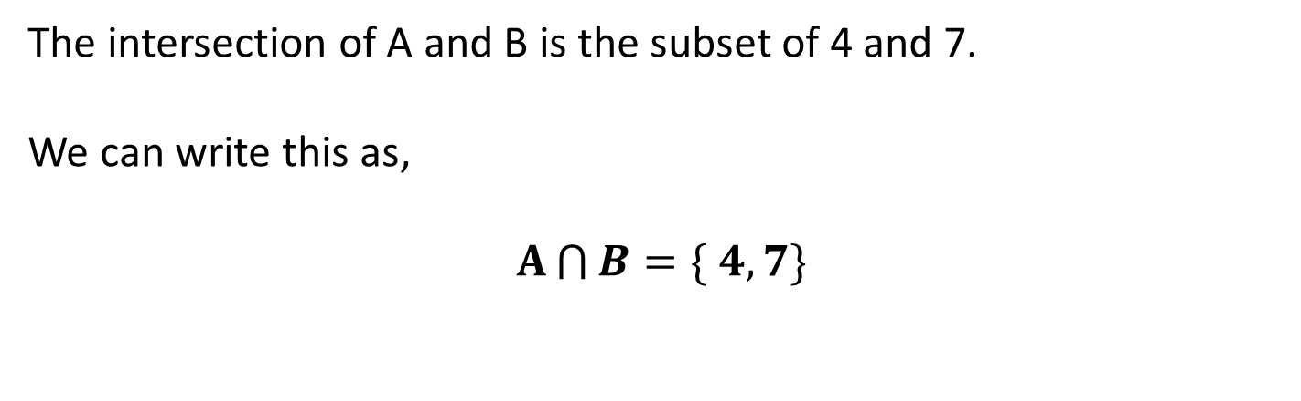
INTERSECTION
The intersection of A and B is the subset of 4 and 7.
We can write this as,
$A\bigcap{B}=\{ 4, 7\}$

Slide 17
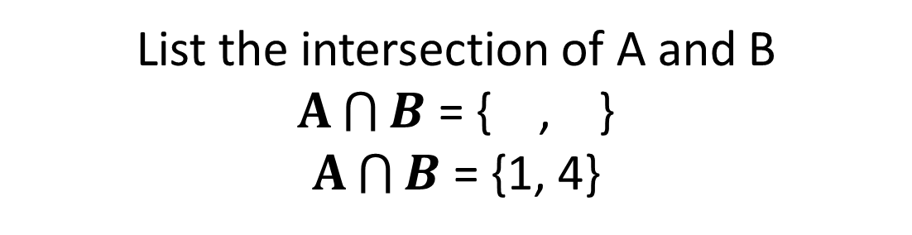
QUESTION
A
B
7
8
6
1
9
3
4
5
2
List the intersection of A and B
$A\bigcap{B}$ = { , }
$A\bigcap{B}$ = {1, 4}

Slide 18
UNION
A union refers to the numbers that appear in any of the sets (circles).
A
B
1
8
6
4
5
9
3
7
2

Slide 19





UNION
A union you will know about is the United Kingdom.
This is the union of England, Northern Ireland, Scotland & Wales.

Slide 20
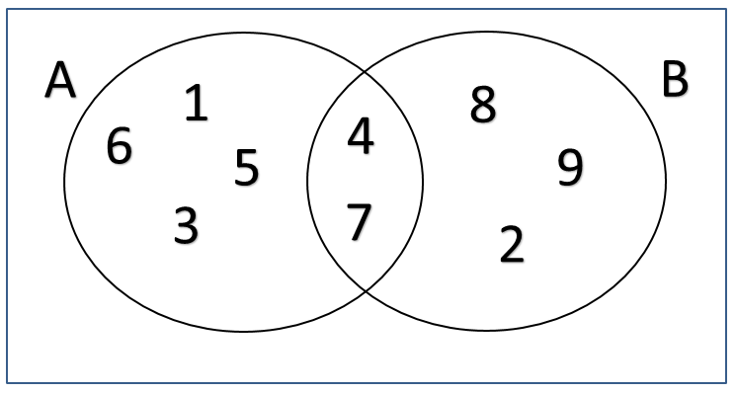
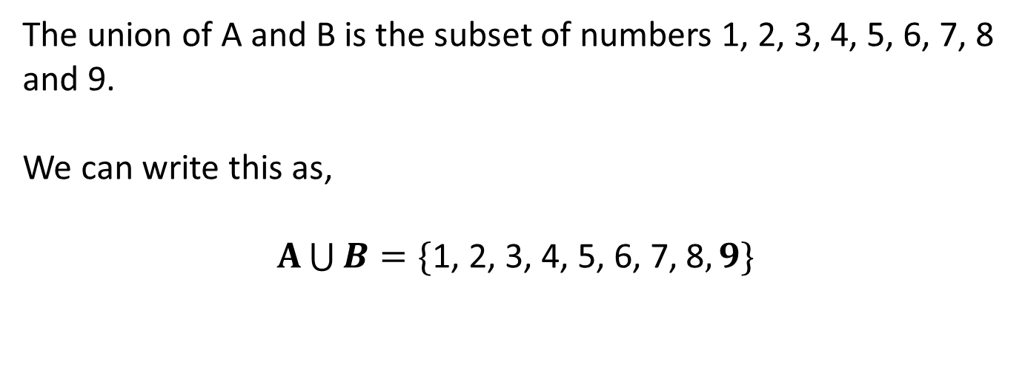
UNION
The union of A and B is the subset of numbers 1, 2, 3, 4, 5, 6, 7, 8 and 9.
We can write this as,
$A\bigcup{B}=\{\text{1, 2, 3, 4, 5, 6, 7, 8}, 9\}$

Slide 22
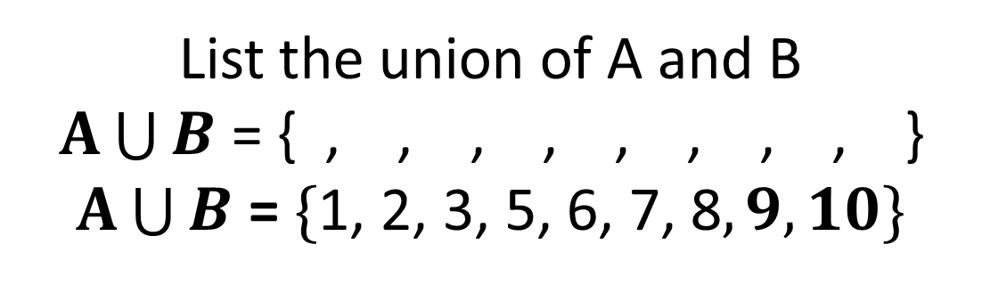
QUESTION
A
B
7
8
6
1
9
3
10
5
2
List the union of A and B
$A\bigcup{B}$ = { , , , , , , , , }
$A\bigcup{B}$ = $\{\text{1, 2, 3, 5, 6, 7, 8}, 9, 10\}$

Slide 23
QUESTION
You are now going to be given a Venn Diagram.
You need to name the following sets/subsets:
Name all of your sets
Describe all of the intersections that exist between your sets.
Name all of the unions that exist between your sets.
Notes:
Different Venn Diagrams available depending on ability.
Could be used to increase level of differentiation in class for mixed ability classes.

Slide 24
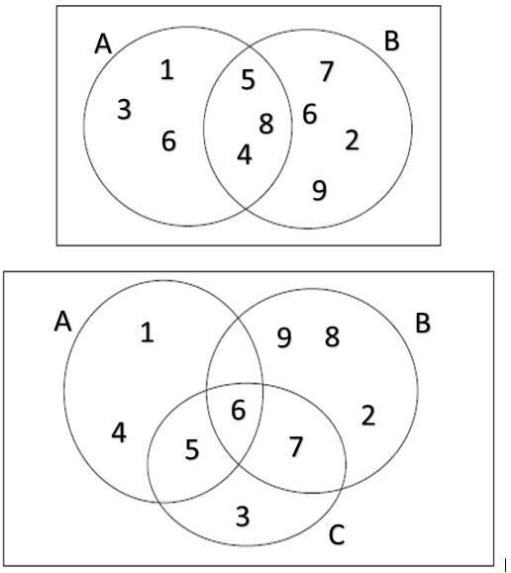
QUESTION
Notes:
Different Venn Diagrams available depending on ability.
Could be used to increase level of differentiation in class for mixed ability classes.

Slide 25
QUESTION
You are now going to be given a Venn Diagram.
You need to name the following sets/subsets.
Name all of your sets
Describe all of the intersections that exist between your sets.
Name all of the unions that exist between your sets.
Notes:
Different Venn Diagrams available depending on ability.
Could be used to increase level of differentiation in class for mixed ability classes.

Slide 26
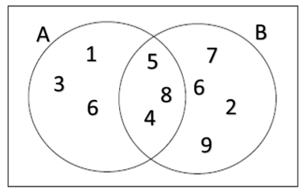
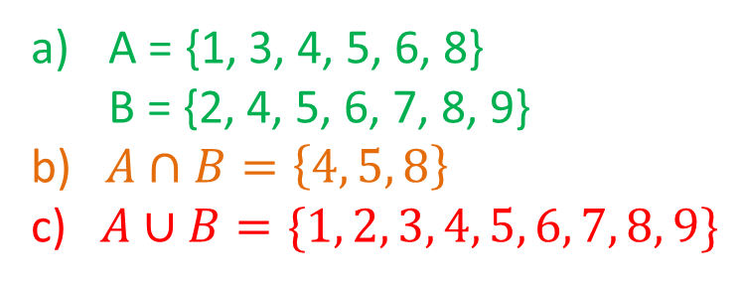
ANSWERS
A = {1, 3, 4, 5, 6, 8}
B = {2, 4, 5, 6, 7, 8, 9}
b) $A∩B=\left\{4, 5, 8\right\}$
c) $A∪B=\{1, 2, 3, 4, 5, 6, 7, 8, 9\}$

Slide 27
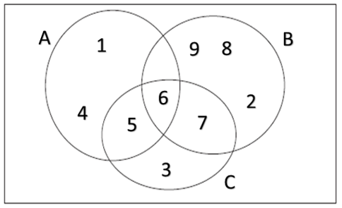
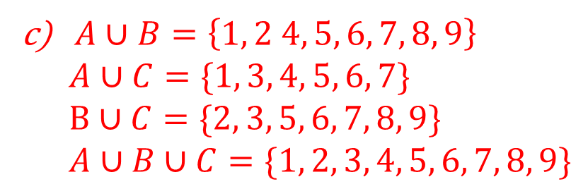
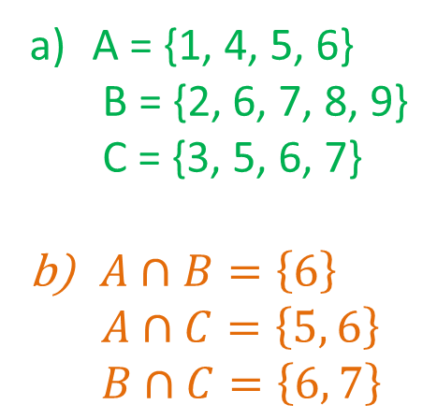
ANSWERS
A = {1, 4, 5, 6}
B = {2, 6, 7, 8, 9}
C = {3, 5, 6, 7}
$A∩B=\left\{6\right\}$
$A∩C=\left\{5, 6\right\}$
$B∩C=\left\{6, 7\right\}$
$A∪B=\left\{1, 2 4, 5, 6, 7, 8, 9\right\}$
$A∪C=\{1, 3, 4, 5, 6, 7\}$
$B∪C=\{2, 3, 5, 6, 7, 8, 9\}$
$A∪B∪C=\{1, 2, 3, 4, 5, 6, 7, 8, 9\}$

Slide 28
SPOT THE MISTAKES
Can you spot the mistakes that have been made in defining information about this Venn diagram.
Hint:
There are more than (>) 2.

Slide 29
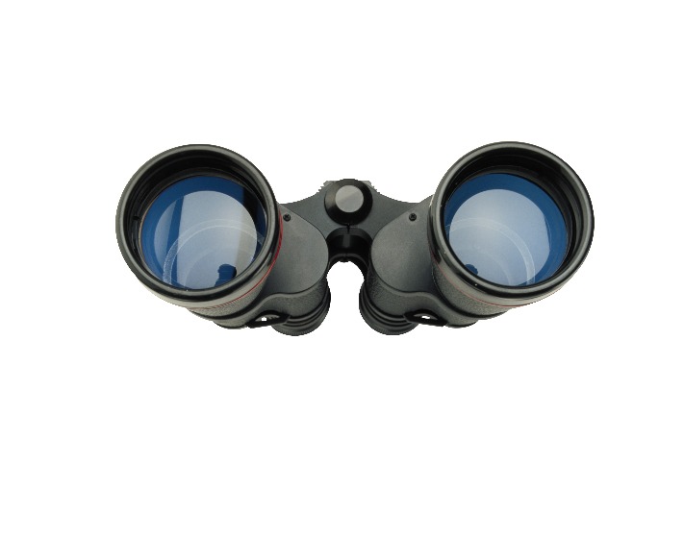
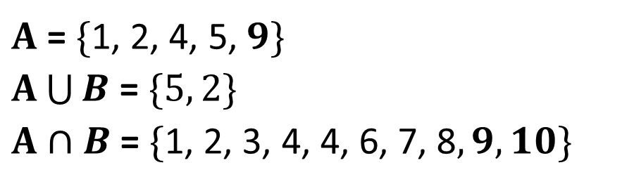
PLENARY
Discuss with the person next to you the mistakes you can identify….
A
B
4
1
5
10
6
9
2
3
4
$A$ = $\{\text{1, }\text{2, 4}\text{, }\text{5}\text{,} 9\}$
$A\bigcup{B}$ = $\{5, 2\}$
$A∩B$ = $\{\text{1, 2, 3, }\text{4, 4}\text{, 6, 7, 8}, 9, 10\}$
Notes:
Simple plenary asking what is wrong with the sets and subsets describing the Venn diagram above.
Could (Can) you draw a Venn diagram (on the board) that matches one of the descriptors below.

Slide 30




Self Evaluation
Now rate yourself for this lesson/topic using the following code:
U – Little (unsatisfactory) effort!
S – Some effort, still room for improvement!!
E – Excellent effort!!!
Little understanding
Some understanding, not completely sure
Excellent understanding

